Slide 1
Lucas Li
A Person Who Regularly Touches Other People

Slide 2
Introduction
1. Lucas Li is a person who has a habit of regularly touching other people.
2. He often initiates physical contact without consent or awareness of personal boundaries.

Slide 3
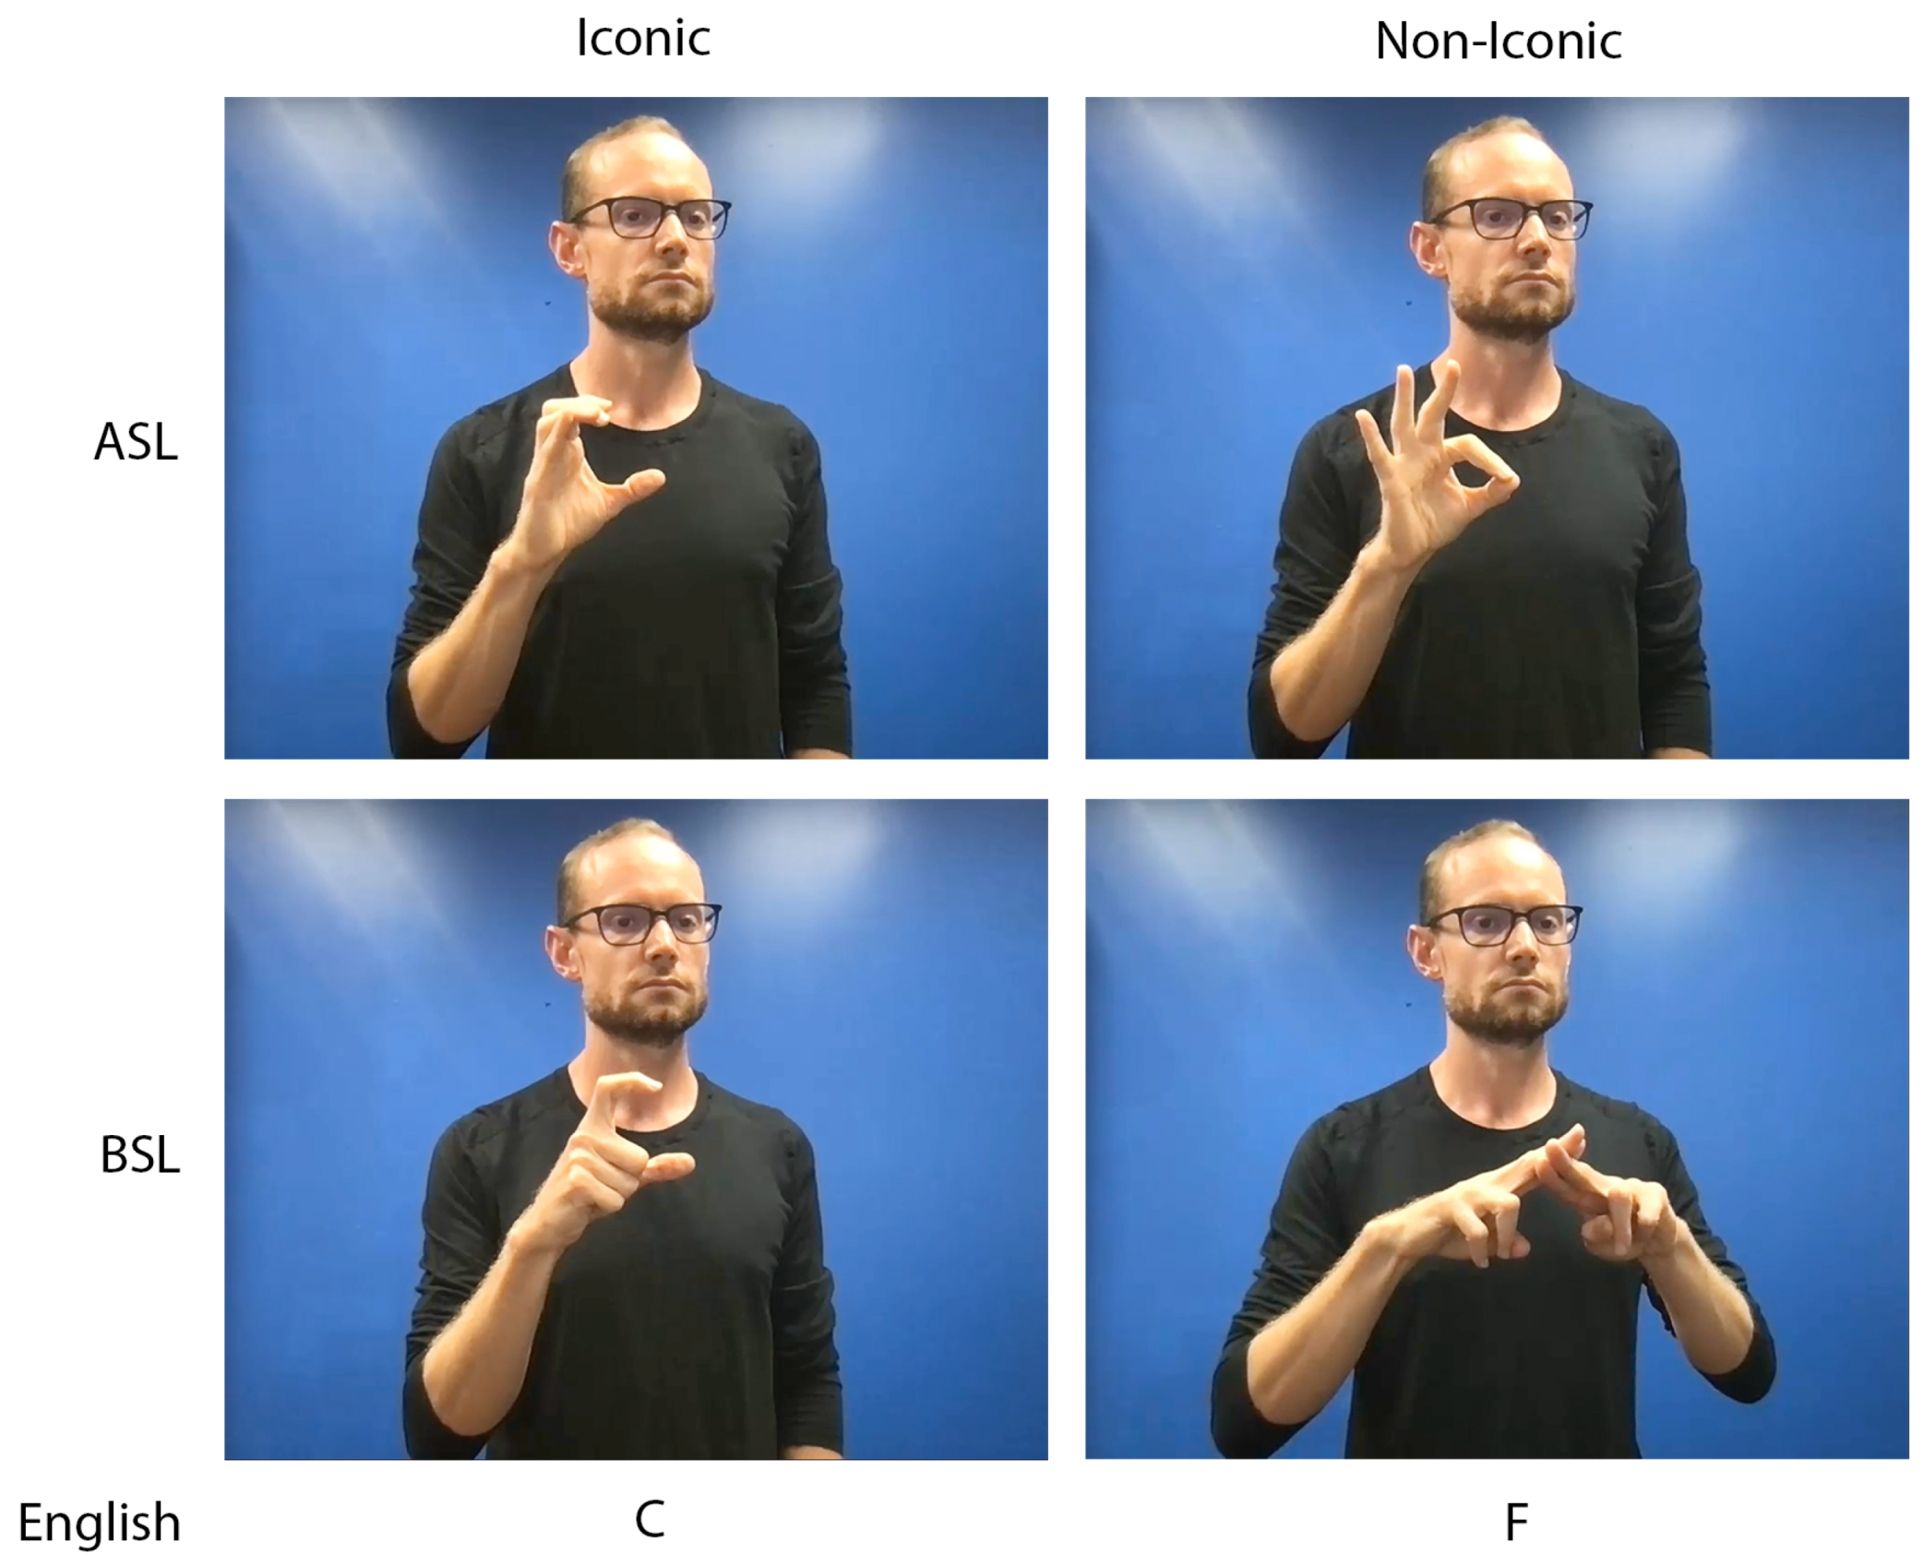
Identifying Lucas Li
1. Lucas Li can be recognized by his frequent and deliberate physical interactions.
2. He touches people on the arms, shoulders, back, and sometimes even their face.
3. His actions are often unwarranted and make others uncomfortable.

Slide 4
Impact of Lucas Li's Behavior
1. Lucas Li's behavior can cause distress and discomfort for the individuals he touches.
2. It can also lead to feelings of invasion of personal space and violation of boundaries.
3. The impact of his actions may vary depending on personal preferences and cultural norms.

Slide 5
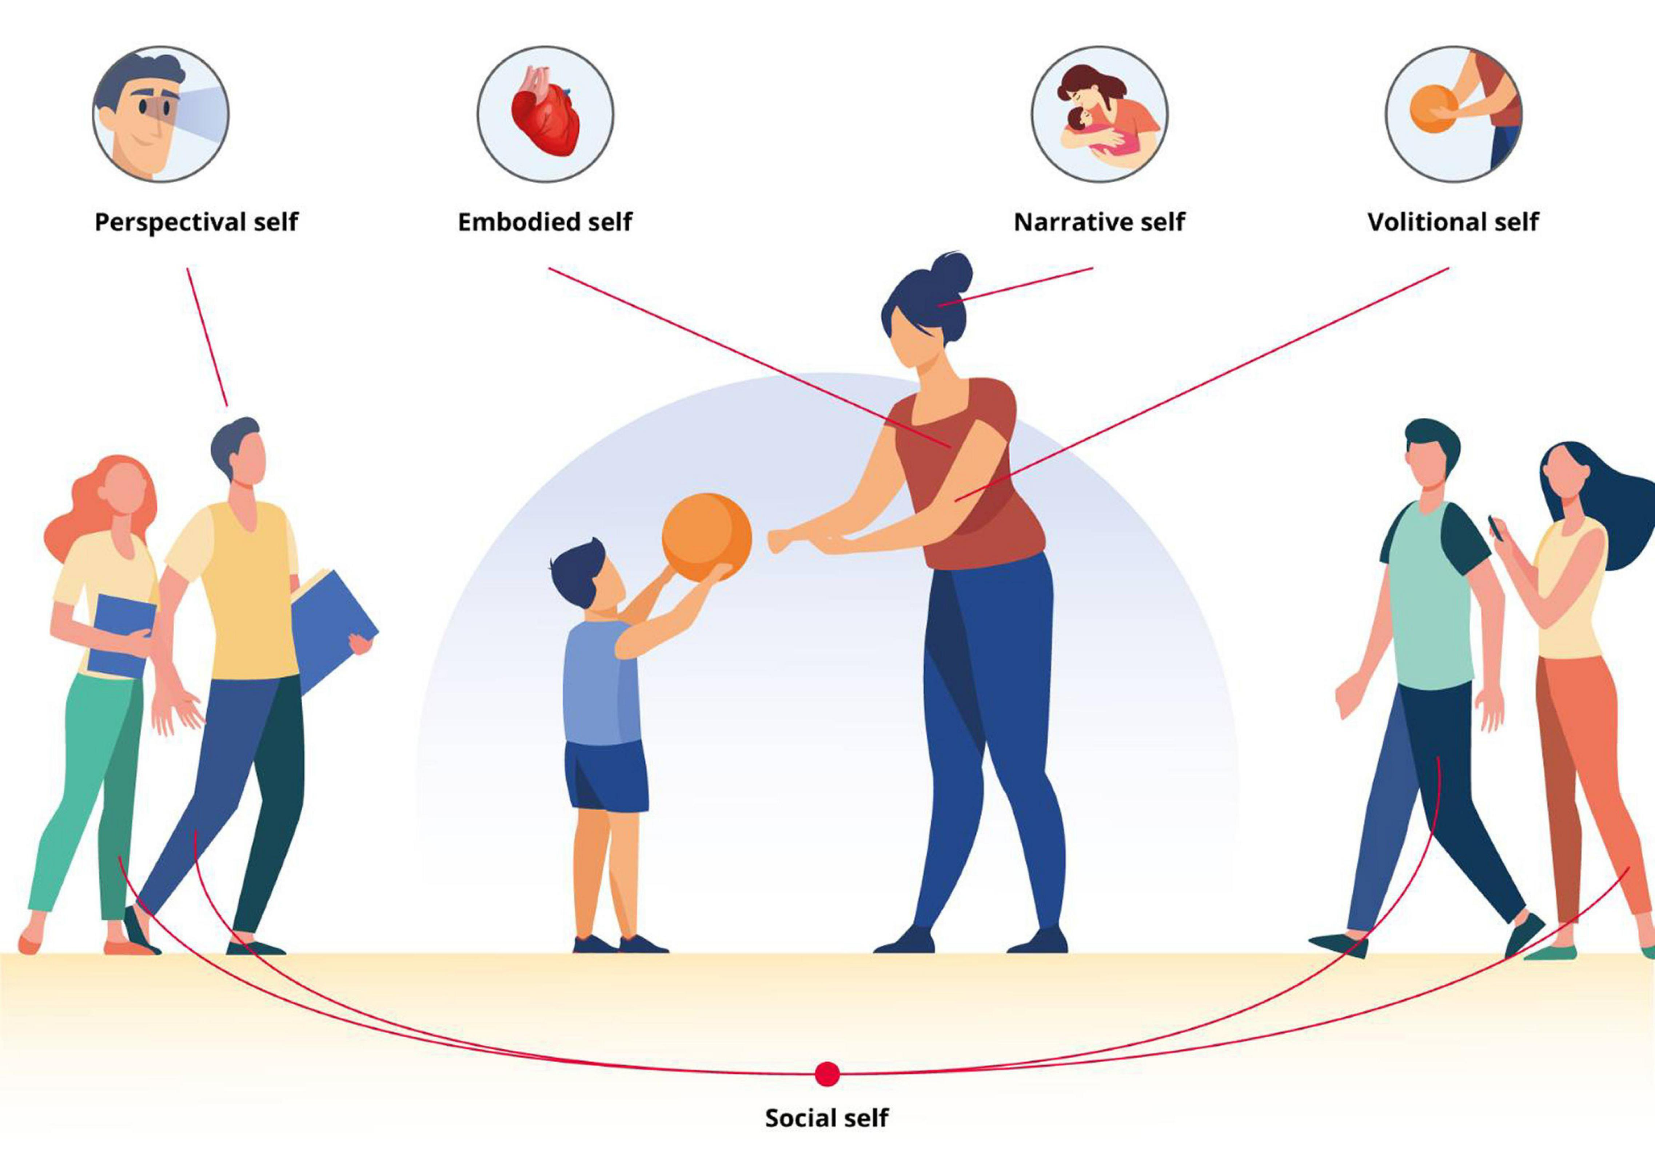
Addressing the Issue
1. It is important to communicate boundaries and express discomfort when dealing with Lucas Li's behavior.
2. Having an open and honest conversation with him can help raise awareness and promote respect for personal space.
3. Encouraging Lucas Li to seek professional help or therapy may also be beneficial in addressing the underlying causes of his behavior.

Slide 6
Thank You

